Slide 1

Mrs A’s Italian restaurant
Which neighbourhood in London is the best to open the restaurant?

Slide 2
The problem:
Mrs A recently moved to London from Italy and is unfamiliar with the different areas.
She needs some help deciding which neighbourhood in London would be the best for her new Italian restaurant.

Slide 3
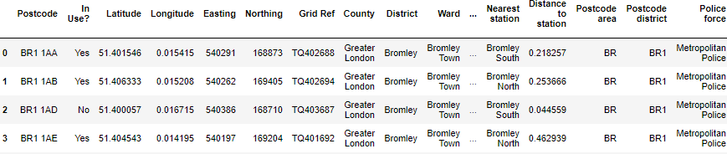
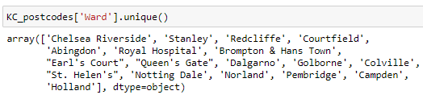
Borough names acquisition & preparation
A list of postcodes and borough names obtained from https://www.doogal.co.uk/london_postcodes.php
After Kensington and Chelsea has been identified as the preferable borough, the postcodes dataframe is filtered to just the wards in that borough. List of unique ward names:

Slide 4
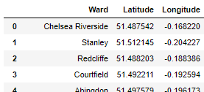
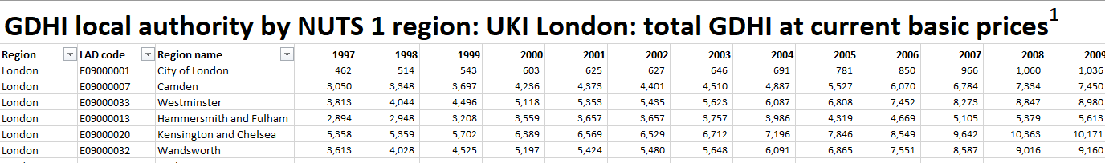
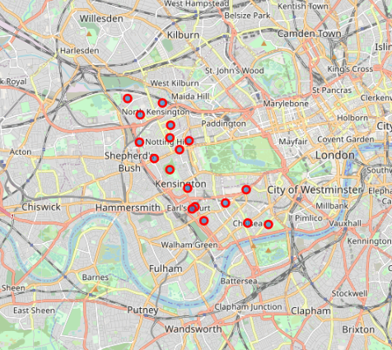
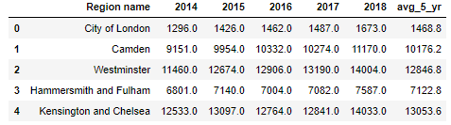

GDHI data acquisition and preparation
Dataset showing the regional gross disposable household income (GDHI) in London from the gov website (https://www.ons.gov.uk/economy/regionalaccounts/grossdisposablehouseholdincome/datasets/regionalgrossdisposablehouseholdincomebylocalauthoritiesbynuts1region)
GDHI dataset with just the last 5 years of data and an average figure in a new column.
Region with the highest average GDHI identified
Each ward within the region now has coordinates obtained via Geopy:
Each ward visualised in Folium:

Slide 5
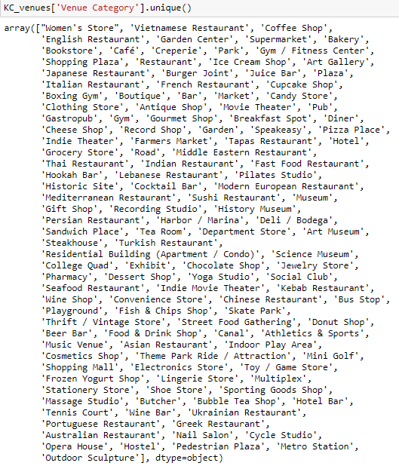
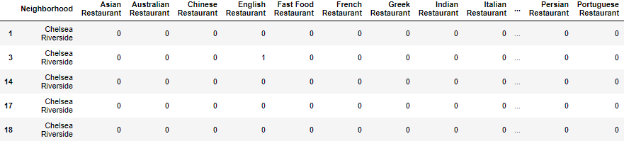
Obtaining nearby venue details
API call to Foursquare made to obtain nearby venue details.
132 categories returned (see right)
One hot encoding used to convert categorical data to numerical:

Slide 6
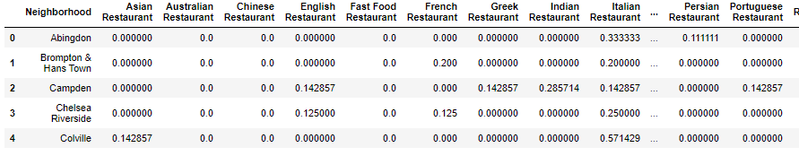
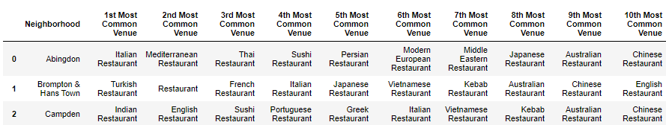
Most common restaurant types
One hot encoding used to convert categorical data to numerical and mean for each category obtained:
Restaurant types ordered by frequency for each neighbourhood:

Slide 7
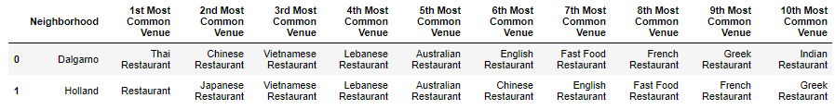

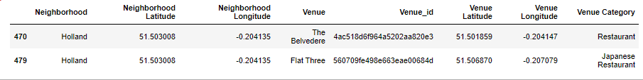
Least competition
We can see that Italian restaurants are very common in quite a few of the neighbourhoods. We want to find neighbourhoods in which Italian restaurants are not very common.
Two neighbourhoods identified:
Looking at all restaurants for each of the two neighbourhoods:

Slide 8
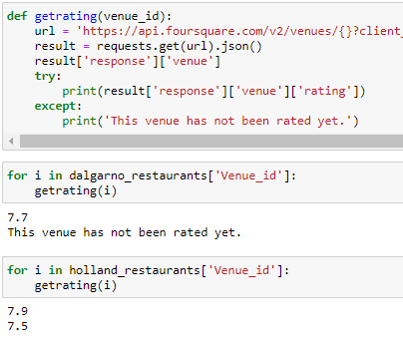
Highest ratings
So we’ve identified two possible locations, both of which have two existing restaurants. How do we choose between these two locations?
By calling the foursquare API to obtain the average venue ratings for each of the restaurants this can give us some clue about the success of the restaurants. Of the two locations Holland has the highest average rating and, importantly, a higher number of ratings.

Slide 9
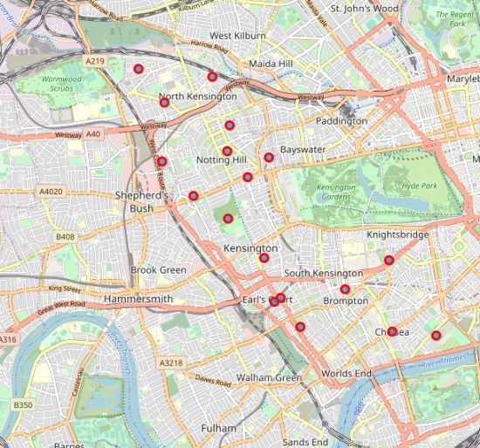
Conclusion
From our analysis we can conclude that the ward of Holland is the preferable location for Mrs A’s new Italian restaurant as it belongs to a borough with a high gross household disposable income, there are no nearby Italian restaurants to compete with and the businesses already in the location are successful with good reviews.
To further this analysis, business rates and available premises would need to be considered but this provides a useful starting point for Mrs A.

